Slide 1
Amazon
Somaiya Vidyavihar University 2022-2023
Name : Harsh Chheda

Slide 2


Relational vs. Non-Relational Architecture
Relational Non-Relational
Rational
Predictable
Traditional
Agile
Flexible
Modern
2

Slide 3









Big Data Challenges
UNSTRUCTURED
STRUCTURED
HIGH
MEDIUM LOW
Archives | Docs | Business | Media | Social | Public | Data | Machine | Sensor
 |  | Apps |  | Networks | Web | Storages | Log Data | Data
Complexity
Velocity
Variety
Volume
Archives
Scanned documents, statements, medical records, e-mails etc..
Media
Images, video, audio etc.
Data Storages
RDBMS, NoSQL, Hadoop, file systems etc.
Docs
XLS, PDF, CSV, HTML, JSON etc.
Social Networks
Twitter, Facebook, Google+, LinkedIn etc.
Machine Log Data
Application logs, event logs, server data, CDRs, clickstream data etc.
Business Apps
CRM, ERP systems, HR, project management etc.
Public Web
Wikipedia, news, weather, public finance etc
Sensor Data
Smart electric meters, medical devices, car sensors, road cameras etc.
3

Slide 4








Big Data Analytics Use Cases
Low Latency Reliability
Real Time Intelligence
Consumers
Intelligent Agents
Volume Performance
Data Quality Self Service
Data Discovery
Business Reporting
Data Scientists/ Analysts
Business Users
4

Slide 5
Big Data Analytics Reference Architectures
Architecture Drivers:
Reference Architectures:
Volume
Sources
Throughput
Latency
Extensibility
Data Quality
Reliability
Security
Self-Service
Cost
Extended Relational
Non-Relational
Hybrid
5

Slide 6

















Relational Reference Architecture
Data Sources
Integration
Data Storages
Analytics
Presentation
Structured
ETL
Data Warehouses
Query & Reporting
Web Browsers
Semi- Structured
Messaging
Data Marts
OLAP Cubes
Native Desktop
Unstructured
API/ODBC
Operational Data Stores
Advanced Analytics
Mobile Devices
Replication
Web Services
6

Slide 7
















Non-Relational Reference Architecture
Data Sources
Integration
Data Storages
Analytics
Presentation
Structured
ETL
NoSQL
Databases
Query & Reporting
Web Browsers
Semi- Structured
Messaging
Distributed File Systems
Map Reduce
Native Desktop
Unstructured
API
Search Engines
Mobile Devices
Advanced Analytics
Web Services
Key components introduced with non-relational movement
10

Slide 8







Big Data Analytics Use Cases
Real Time Intelligence
Consumers
Intelligent Agents
Performance Volume
Data Discovery
Business Reporting
Data Scientists
Business Users
8

Slide 9





















Data Discovery: Non-Relational Architecture
Data Sources
Integration
Data Storages
Analytics
Presentation
Structured
ETL
NoSQL
Databases
Query & Reporting
Web Browsers
Semi- Structured
Messaging
Distributed File Systems
Map Reduce
Native Desktop
Unstructured
API
Search Engines
Mobile Devices
Advanced Analytics
Web Services
9

Slide 10




Big Data Analytics Use Cases
Real Time Intelligence
Consumers
Intelligent Agents
Data Quality Self Service
Data Discovery
Business Reporting
Data Scientists
Business Users
10

Slide 11




















Business Reporting: Hybrid Architecture
Data Sources
Integration
Data Storages
Analytics
Presentation
Structured
ETL
Relational DWH/DM
SQL Query & Reporting
Web Browsers
Semi- Structured
Messaging
Distributed File Systems
Map Reduce
Native Desktop
Unstructured
API
Search Engines
Mobile Devices
Advanced Analytics
Web Services
Extended Relational components
Non-relational components
18

Slide 12


Big Data Analytics Use Cases
Low Latency Reliability
Real Time Intelligence
Consumers
Intelligent Agents
Data Discovery
Business Reporting
Data Scientists
Business Users

Slide 13
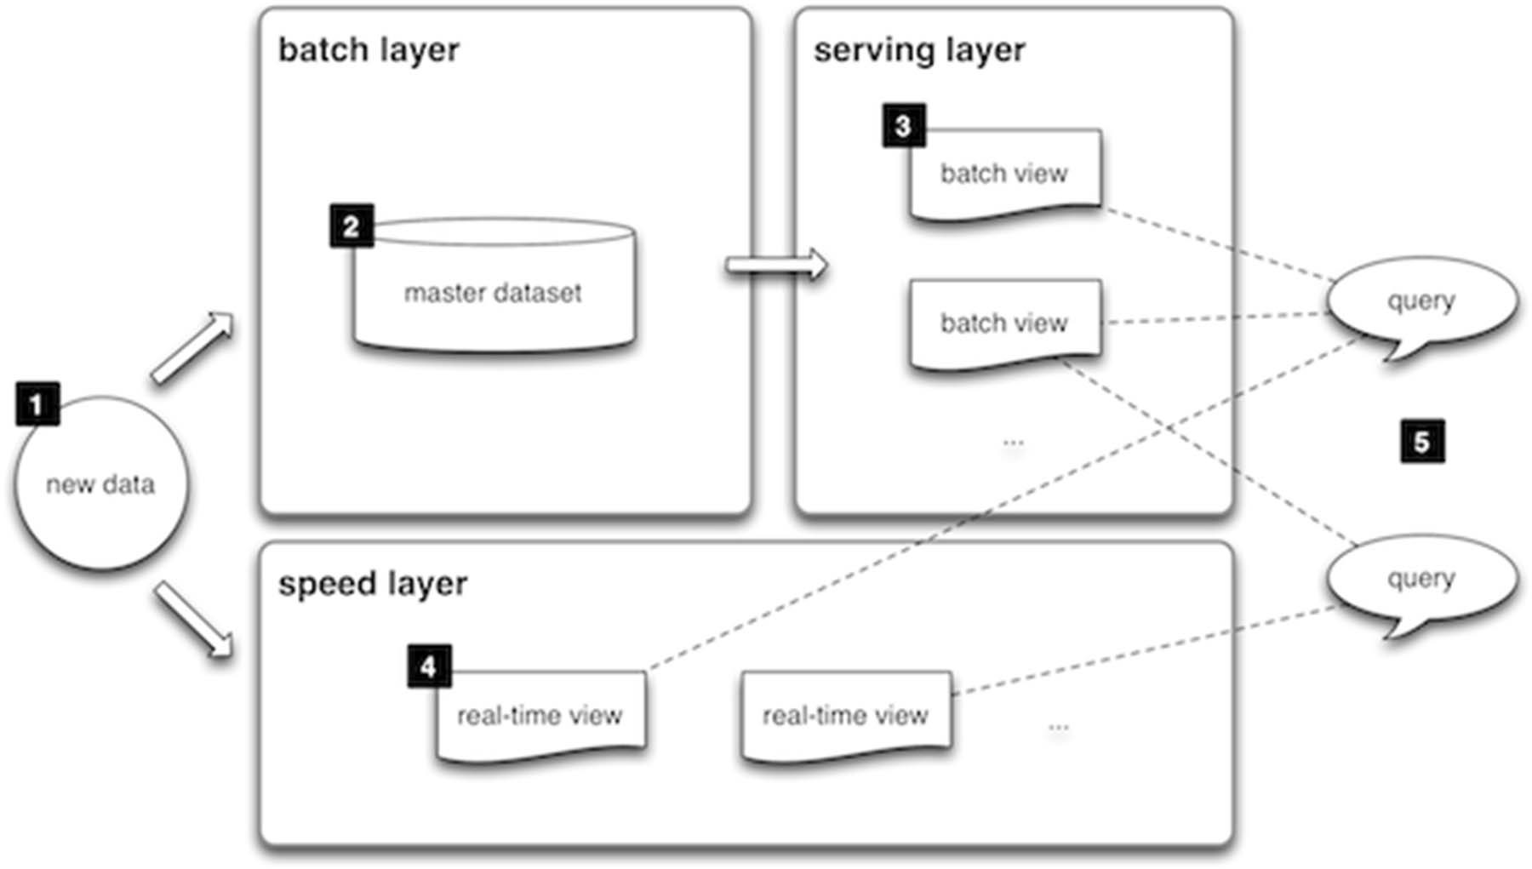
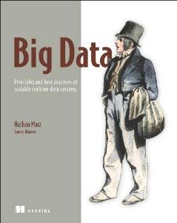
Lambda Architecture
Source:

Slide 14
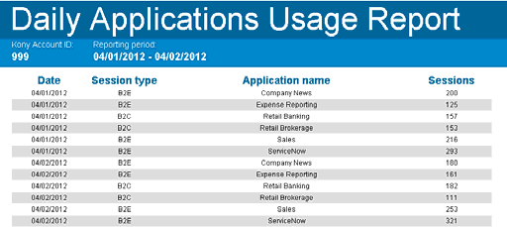
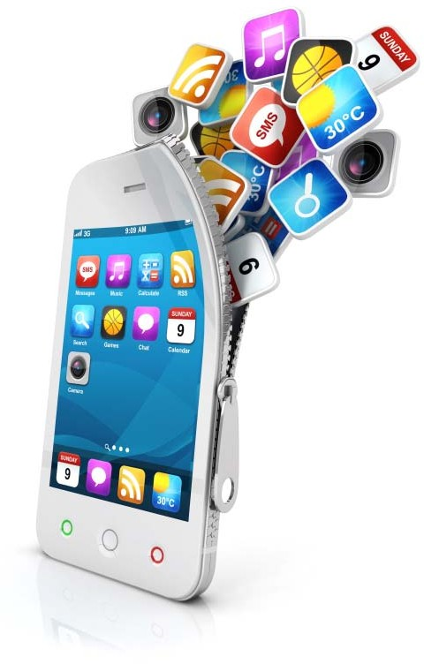
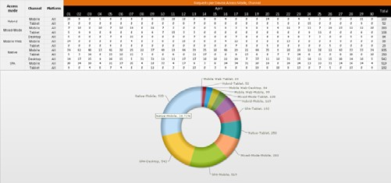

Case Study #1: Usage & Billing Analysis
Business Goals:
Business Area:
Cloud based platform for building, deploying, hosting and managing of mobile applications
Provide visual environment for building custom mobile application
Charge customers based on the platform they are using, number of consumers’ applications etc.

Slide 15


Architectural Decisions
Architecture Drivers:
Volume (> 10 TB)
Sources (Semi-structured - JSON)
Throughput (> 10K/sec)
Latency (2 min)
Extensibility (Custom metrics)
Data Quality (Consistency)
Trade-off:
Reliability (24/7)
Security (Multitenancy)
Self-Service (Ad-Hoc reports)
Cost (The less the better ☺)
Constraints (Public Cloud)
 | Extended Relational | Non-Relational
Extensibility | ‐ | +
Data Quality | + | ‐
Self-Service | + | ‐
Extended Relational Architecture
Extensibility via Pre‐allocated Fields pattern

Slide 16
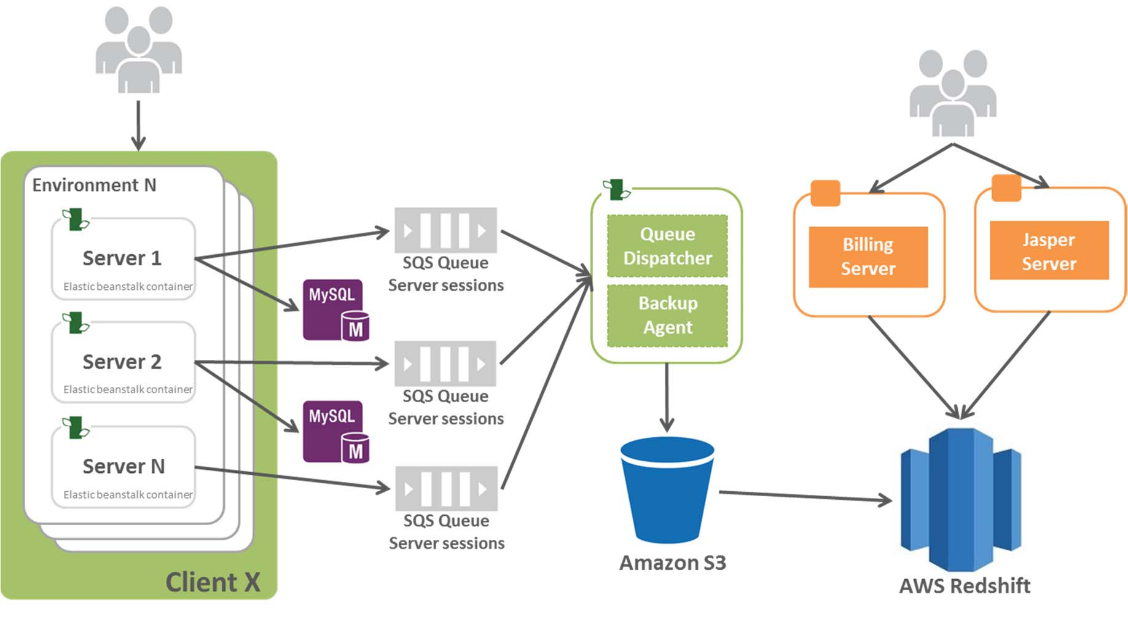
Solution Architecture
Technologies:
Amazon Redshift
Amazon SQS
Amazon S3
Elastic Beanstalk
Jaspersoft BI Professional
Python

Slide 17
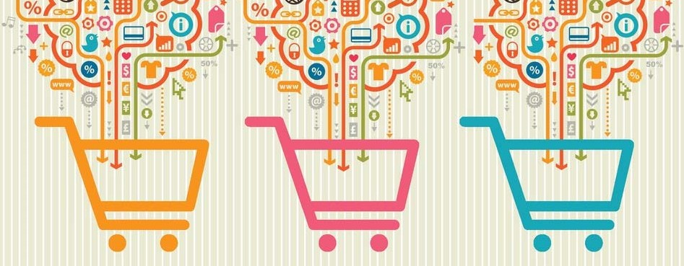
Case Study #2: Clickstream for retail website
Business Goals:
Build in-house Analytics Platform for ROI measurement and performance analysis of every product and feature delivered by the e-commerce platform;
Provide the ability to understand how end-users are interacting with service content, products, and features on sites;
Do clickstream analysis;
Perform A/B Testing
Business Area:
Retail. A platform for e-commerce and collecting feedbacks from customers

Slide 18


Architectural Decisions
Architecture Drivers:
Volume (45 TB)
Sources (Semi-structured - JSON)
Throughput (> 20K/sec)
Latency (1 hour)
Extensibility (Custom tags)
Data Quality (Not critical)
Trade-off:
Reliability (24/7)
Security (Multitenancy)
Self-Service (Canned reports, Data science)
Cost (The less the better ☺)
Constraints (Public Cloud)
 | Extended Relational | Non- Relational
Volume/Scalability | +/‐ | +
Throughput | + | +
Self-Service | + | +/‐
Extensibility | ‐ | +
Non‐Relational Architecture
Reporting via Materialized View
pattern

Slide 19
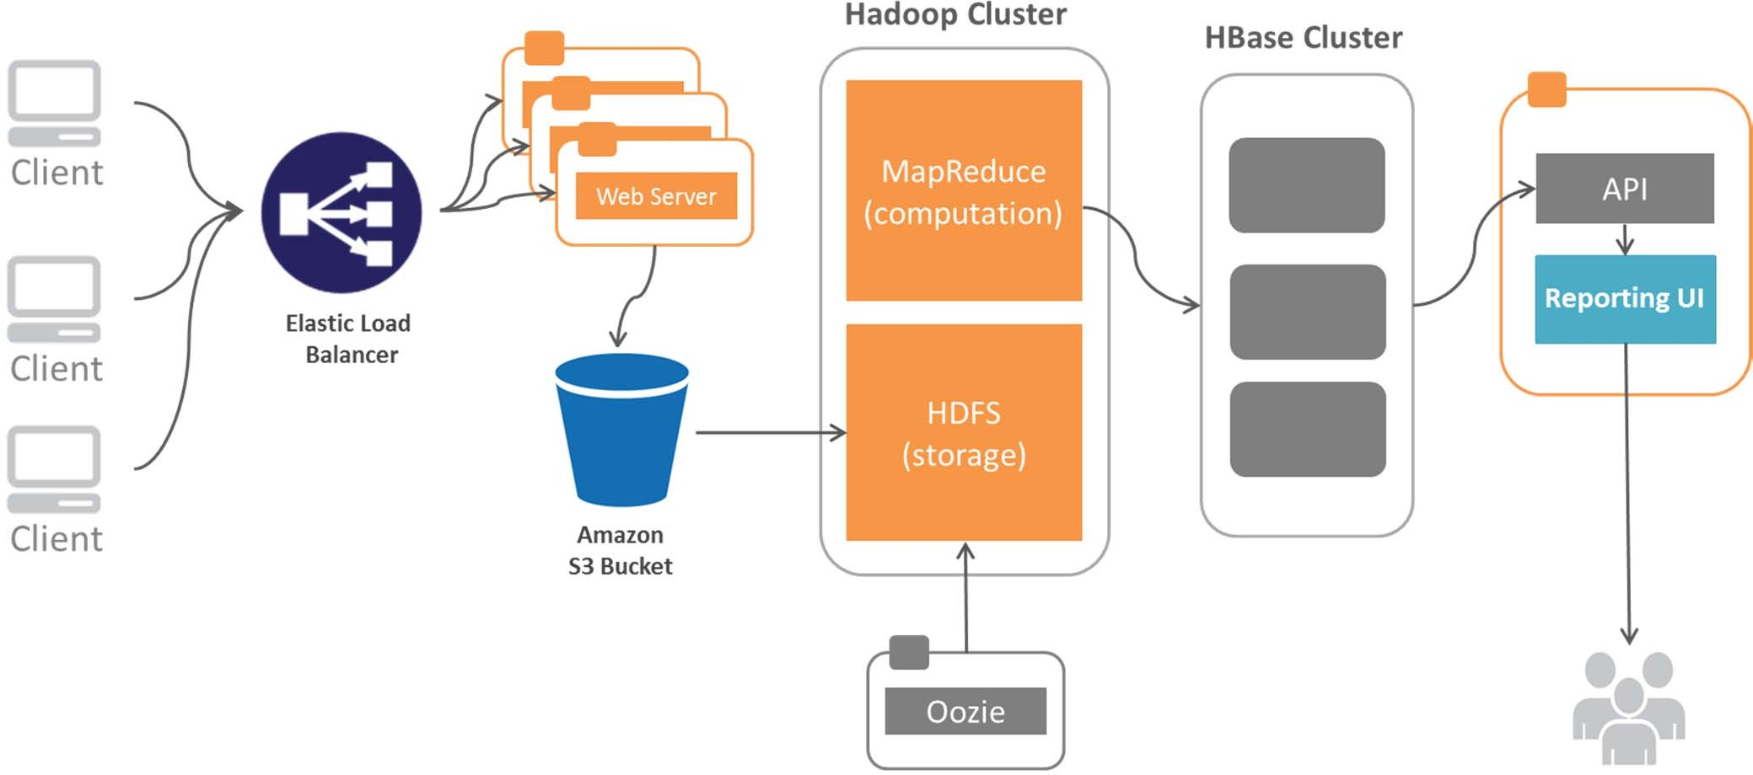
Solution Architecture
Technologies:
Amazon S3
Flume
Hadoop/HDFS, MapReduce
HBase
Oozie
Hive
Node 1
Node 2 Node N

